Slide 1
電腦視覺與深度學習 (Computer Vision and Deep Learning) Homework 2
TA:
Lydia: lydia2200284@gmail.com
Office Hour: 17:00~19:00, Mon.
10:00~12:00, Wed.
At CSIE 9F Robotics Lab.

Slide 2
Notices (1/2)
Copying homework is strictly prohibited!! Penalty: Grade will be zero for both persons!!
If the code can’t run, you can come to our Lab within one week and show that your programming can work. Otherwise you will get zero!!
Due date => Midnight 23:59:59 on 2020/12/30 (Wed.)
No delay. If you submit homework after deadline, you will get 0.
Upload to => 140.116.154.1 -> Upload/Homework/Hw2
User ID: cvdl2020 Password: cvdl2020
Format
Filename: Hw2_StudentID_Name_Version.rar
Ex: Hw2_F71234567_林小明_V1.rar
If you want to update your file, you should update your version to be V2, ex: Hw2_F71234567_林小明_V2.rar
Content: project folder*( including the pictures ) *note: remove your “Debug” folder to reduce file size

Slide 3
Notices (2/2)
Python
Python 3.7 (https://www.python.org/downloads/)
opencv-contrib-python (3.4.2.17)
Matplotlib 3.1.1
UI framework: pyqt5 (5.15.1)
C++ (check MFC guide in ftp)
OpenCV 3.3.1 (https://opencv.org/release.html)
Visual Studio 2015 (download from http://www.cc.ncku.edu.tw/download/)
UI framework: MFC

Slide 4
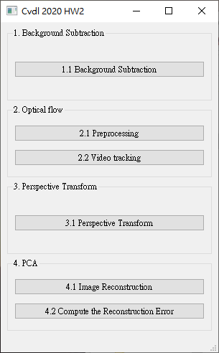
Grading
1. (20%) Background Subtraction (出題：Brian)
2. (20%) Optical Flow (出題：Kevin) 2.1 Preprocessing (10%)
2.2 Video tracking (10%)
3. (20%) Perspective Transform (出題：Max)
4. (20%) PCA (出題：Mark)
4.1 Image Reconstruction (10%)
4.2 Compute the reconstruction error (10%)
5. (20%) Dogs and Cats classification Using ResNet50 (出題：Bill)
UI example

Slide 5
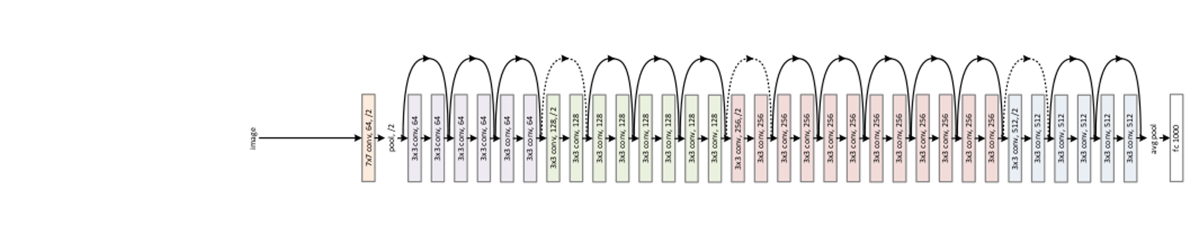
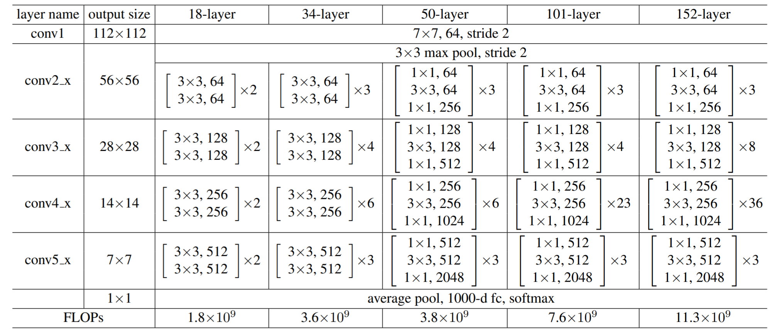
5.0 (20%)Dogs and Cats classification Using ResNet50 (出題：Bill)
1) Dataset introduction:
ASIRRA (Animal Species Image Recognition for Restricting Access) is a HIP(Human Interactive Proof) that works by asking users to identify photographs of cats and dogs, that's supposed to be easy for people to solve, but difficult for computers. Now we can use artificial intelligence technology to achieve this goal.
(2) The dataset includes 12501 photos of cats and 12501 photos of dogs. You need to download them in Reference below(R2), and split the training set, validation set and test set by yourself.
2) Objective:
You need to use python to write the ResNet network
and complete the questions on the next few pages.
3) Environment Requirement
(1) Python 3.6
(2) Tensorflow 1.14
(3) Opencv-contrib-python 4.1.1 (for image show and write)
Fig. ResNet’s Network Architecture
R. Reference
R1) Deep Residual Learning for Image Recognition
R2) https://www.microsoft.com/en-us/download/details.aspx?id=54765 (ASIRRA)
Fig. ResNet50's Schematic Diagram

Slide 6
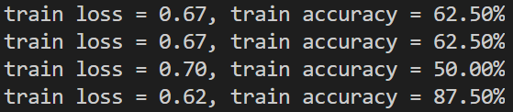
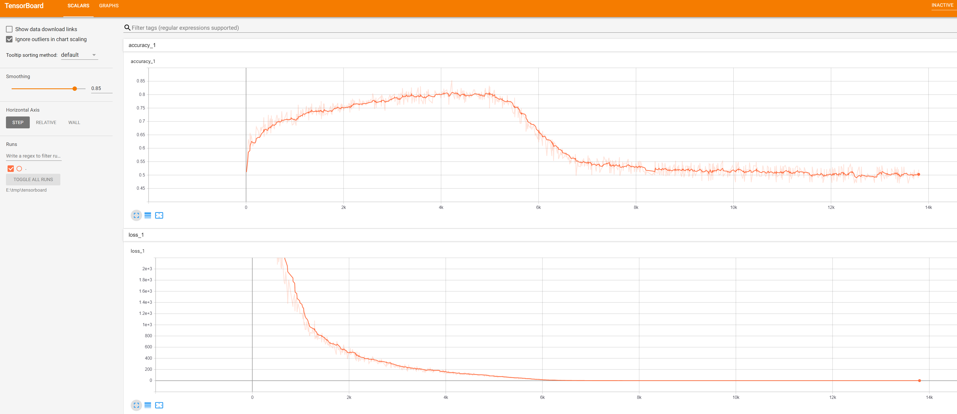
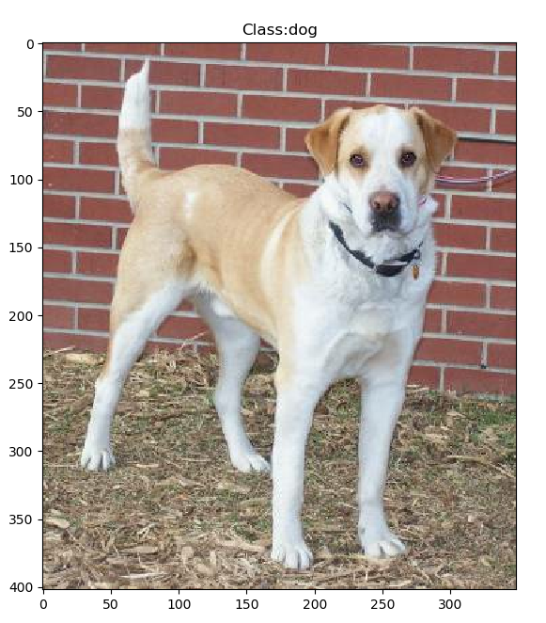
5.1 Training by your computer at least 5 epochs and show(or upload) your source code of ResNet. (5%)
Fig. Accuracy display during training
5.2 Training at home and use TensorBoard to monitor, Save the final screenshot of TensorBoard (5%, Use other tools can get 3%).
Fig. Example of training with TensorBoard
5.3 Randomly select a picture from the test set and mark its category.(5%)
Fig. Classification display example

Slide 7
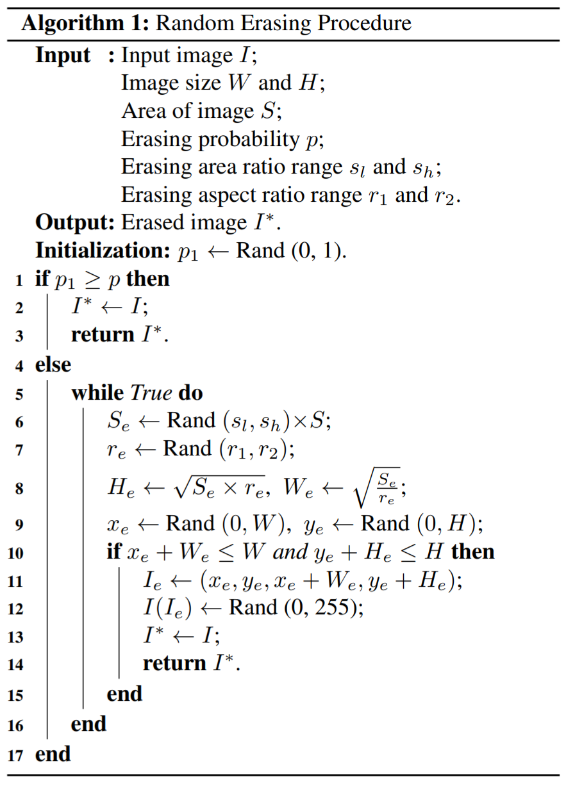
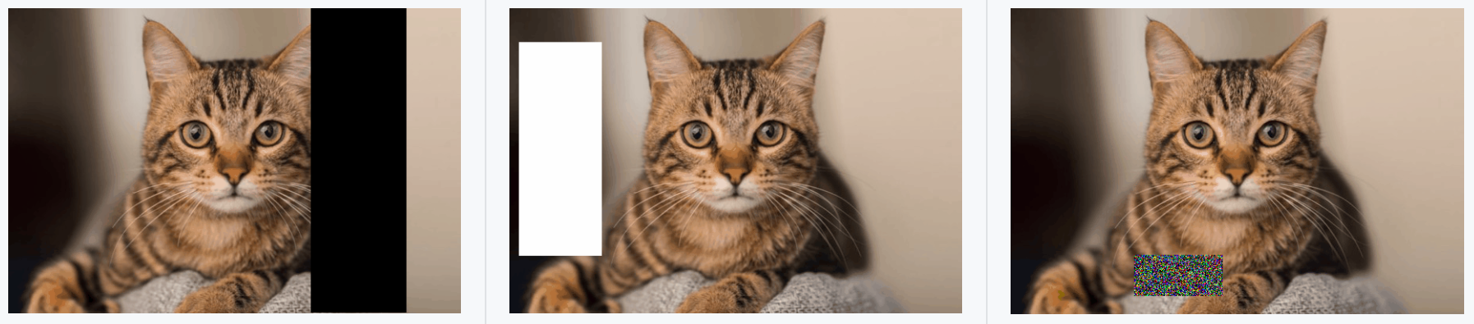
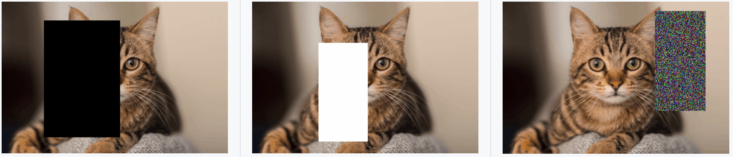
5.4 Improve ResNet50 with the method in yolov4:
Due to the early appearance of ResNet50, many augmentation methods have not implemented. In the latest ResNet50, Random-Erasing have been used to greatly improve the accuracy, so why don‘t we use this method on ResNet50? Write the code of Random-Erasing (3%) and draw the comparison table of accuracy, save it as a picture.(2%)
Fig. Random-Erasing algorithm
Fig. Examples of the use of Random-Erasing
R. Reference
Random Erasing Data Augmentation
Fig. Random-Erasing effect comparison example

